Slide 1
US Cancer Incidence and Mortality 2016
Top Ten Cancers Causing Deaths
All Cancers, All Ages, All Races, Both Male and Female, 2016
Maryland
US
Lung and Bronchus: Cause of Most Cancer Deaths
All Ages, All Races, Both Male and Female, 2016
Shown by State
Comparison in 3 States: Top Ten Cancers
All Cancers, All Ages, All Races, Both Male and Female, 2016
Alabama, Alaska, and Arizona

Slide 2
US Cancer Incidence and Mortality
Cancer Rate (rate per 100,000 people): This number is represented as a percentage
Rate of cancer diagnoses
Rate of cancer deaths
Cancer Case Count
Cancer Incidence: the number of new cases diagnosed.
Cancer Mortality: the number of cancer deaths.
Cancer Trends: change over time
Cancer Rate Trends
Cancer Case Count Trends
NOTE: It is possible for the rate over time to trend down even though the counts increase during the same timespan. This is due to the increase in population.

Slide 3
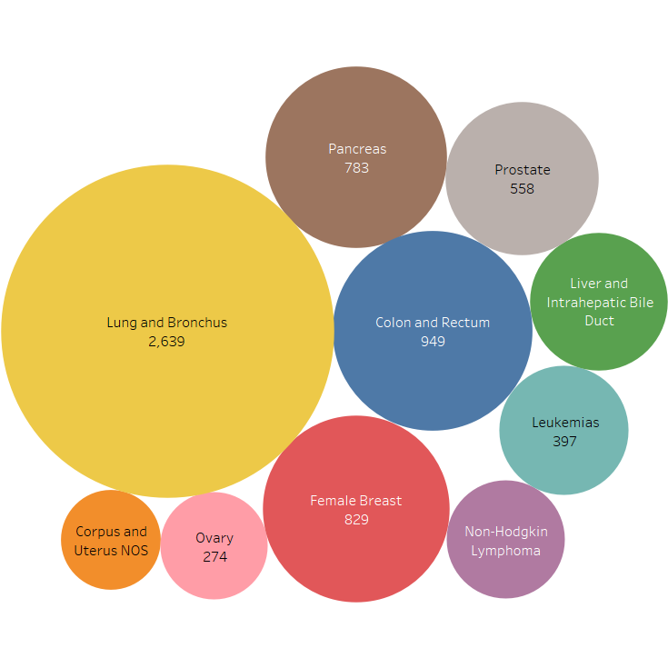
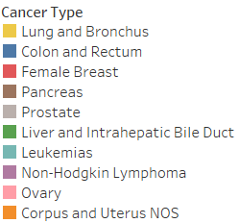
US Cancer Incidence and Mortality
Maryland: Top Ten Cancers Causing Deaths
All Cancers, All Ages, All Races,
Both Male and Female
2016

Slide 4
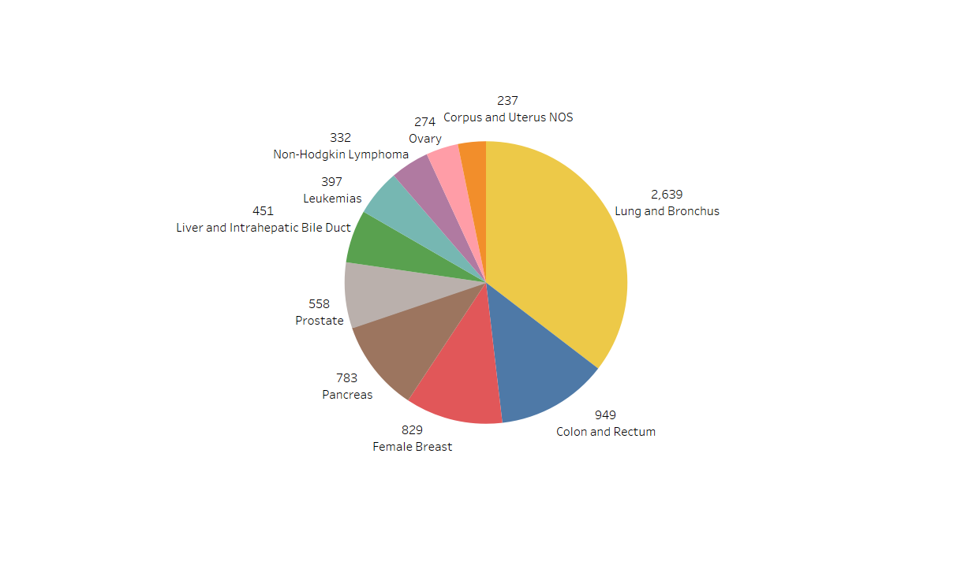
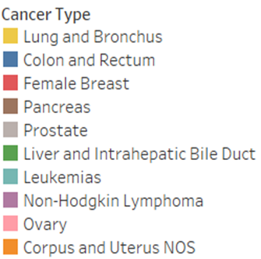
US Cancer Incidence and Mortality
Maryland: Top Ten Cancers Causing Deaths
All Cancers, All Ages, All Races,
Both Male and Female
2016

Slide 5
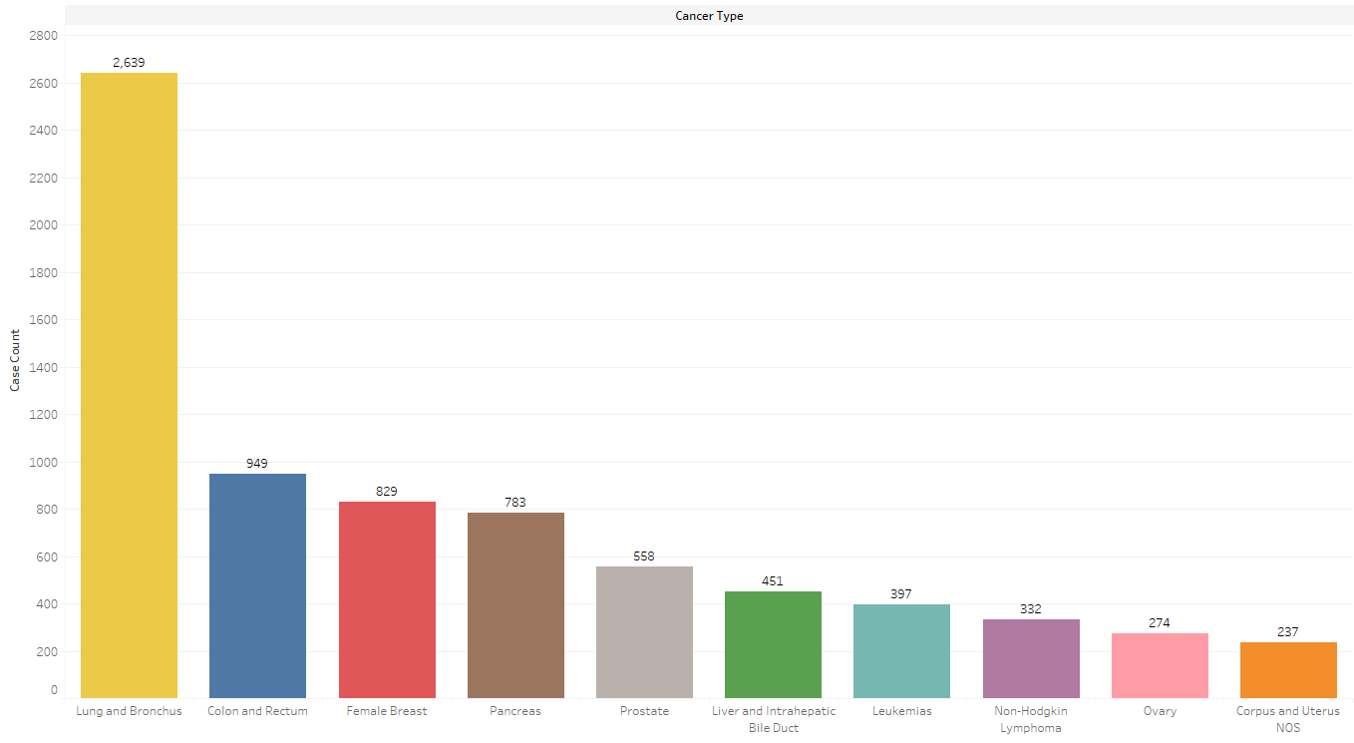

US Cancer Incidence and Mortality
Maryland: Top Ten Cancers Causing Deaths All Cancers, All Ages, All Races, Both Male and Female 2016

Slide 6
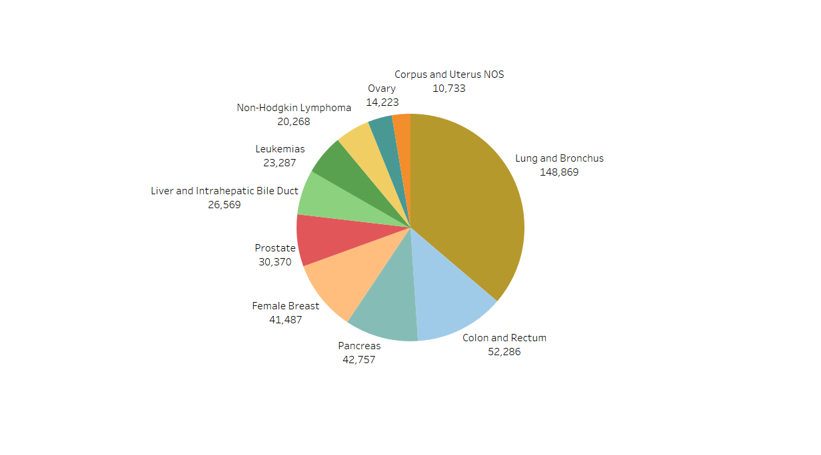
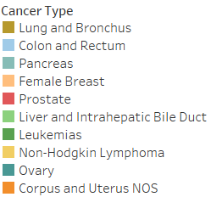
US Cancer Incidence and Mortality
US Top Ten Cancers Causing Deaths in 2016

Slide 7
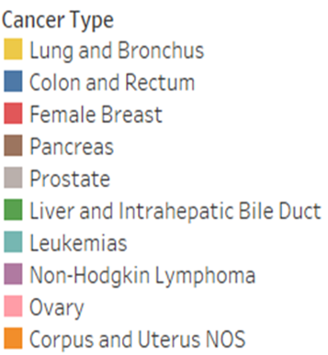

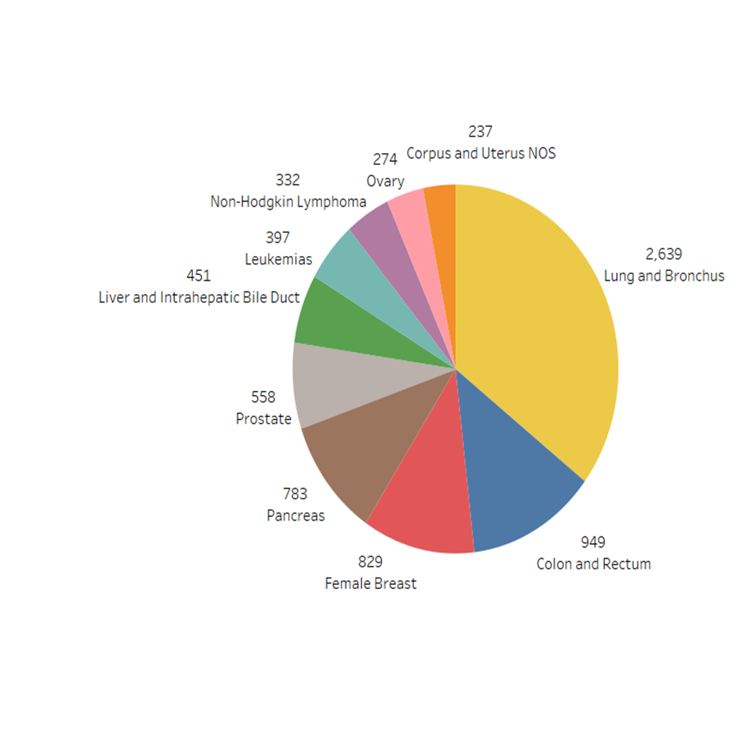
US Cancer Incidence and Mortality
US Versus Maryland Top Ten Cancers Causing Deaths in 2016

Slide 8
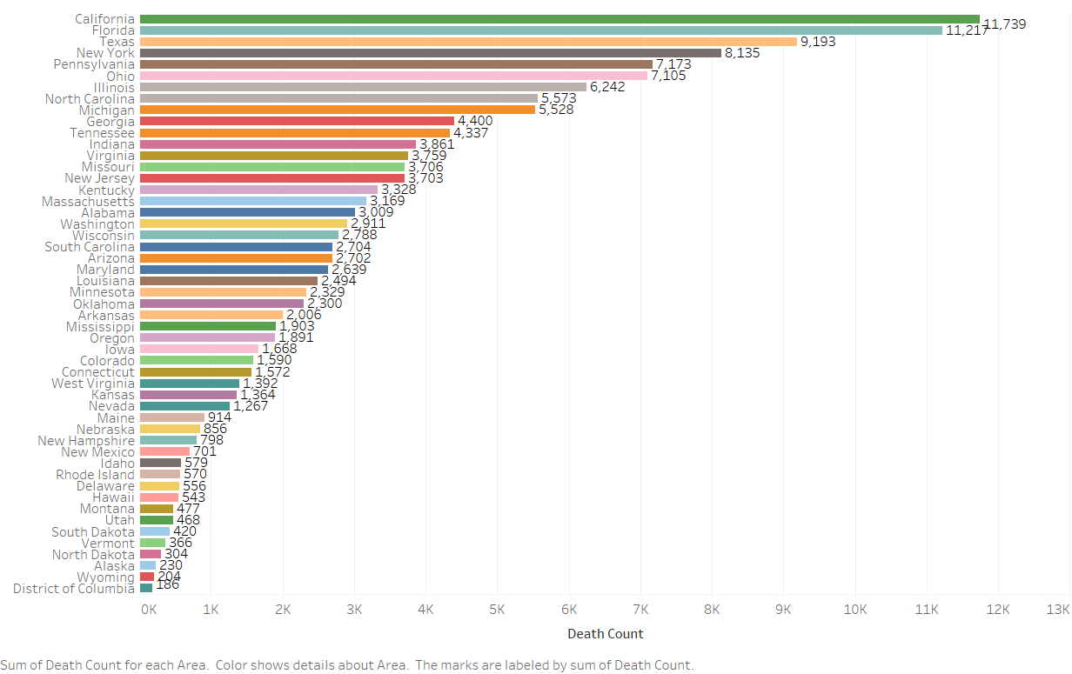
US Cancer Incidence and Mortality
US Lung and Bronchus: Cause of Most Cancer Deaths Shown by State

Slide 9
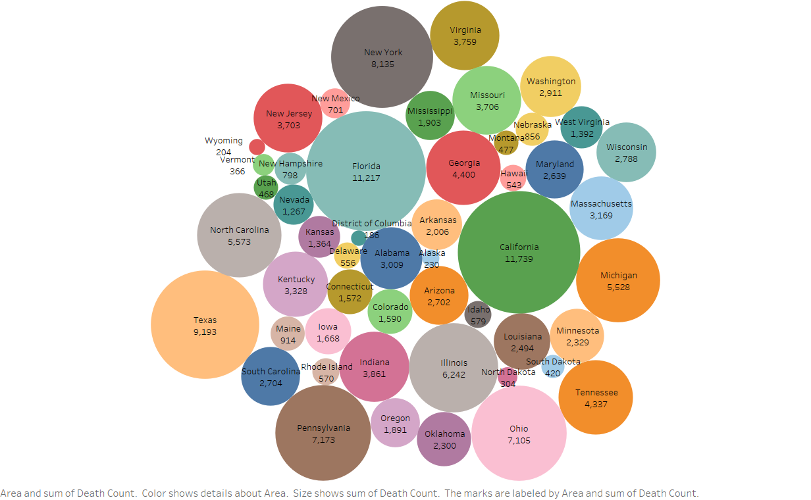
US Cancer Incidence and Mortality
US Lung and Bronchus: Cause of Most Cancer Deaths Shown by State

Slide 10
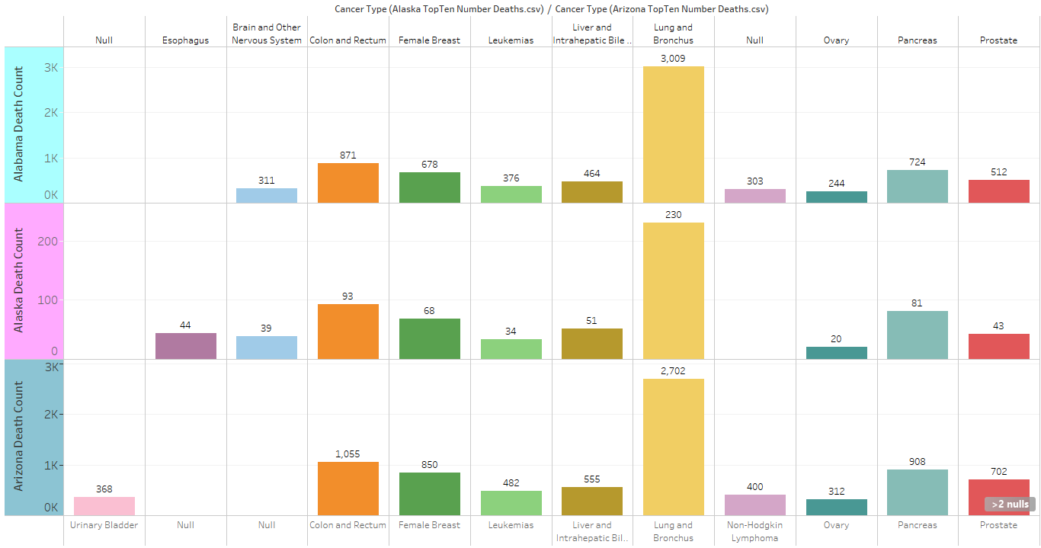
US Cancer Incidence and Mortality
Compare Top Ten Cancers for Alabama, Alaska, and Arizona

